Slide 1

BLOOD BANK MANAGEMENT SYSTEM
BY :-
K. YUVA KISHORE
192224155
M. GOPINADH
192224153

Slide 2


Introduction to Blood Bank Management System
A blood bank management system is a crucial tool for efficiently managing the storage, distribution, and tracking of blood donations. It helps streamline the process of blood inventory management, donor records, and transfusion requests.

Slide 3
Importance of Blood Bank Management
Life-Saving Resource
Public Health Preparedness
Blood banks play a critical role in providing a constant supply of safe blood for transfusions in emergencies and medical treatments.
Effective blood bank management ensures readiness for unforeseen disasters and contributes to public health crisis response.
Supporting Medical Procedures
Ensuring Blood Safety
Blood banks facilitate complex surgical procedures, organ transplants, and treatments for patients with blood disorders.
Proper management maintains the integrity and safety of blood products, reducing the risk of transfusion-related complications.

Slide 4

Features and Benefits of the System
Integrated Database: The system maintains a comprehensive database of donors, blood types, and stock levels for efficient blood management.
Automated Notifications: Donors receive automated reminders for donation schedules, ensuring a consistent blood supply.
Real-time Tracking: Enables real-time tracking of blood units, reducing wastage and improving response time during emergencies.

Slide 5
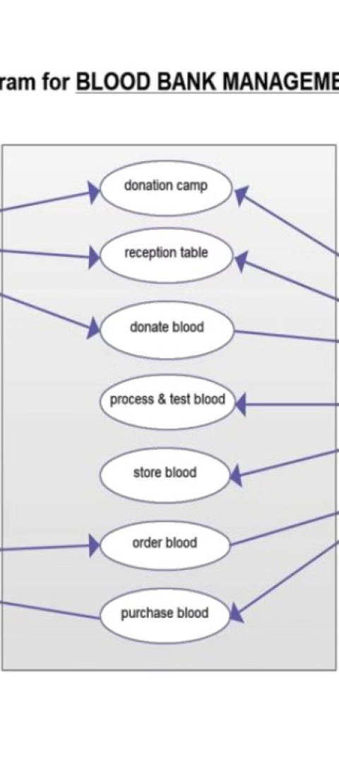
Methodology for Blood Bank Management
1
Inventory Management
Regular stock monitoring and temperature control are crucial to maintain blood quality and quantity.
2
Donor Recruitment & Screening
Establish efficient processes for recruiting and screening potential donors to ensure safety and quality standards.
3
Distribution Protocol
Implement organized systems for tracking, storing, and distributing blood to medical facilities in need.

Slide 6
Key Factors for Blood Bank Management Systems
1
Efficient Inventory Management
2
Accurate Blood Typing and Screening
Tracking blood supplies in real-time to ensure availability for emergency situations.
Implementing rigorous testing processes to provide safe and compatible blood transfusions.
3
Stringent Quality Control Measures
4
Effective Donor Recruitment Strategies
Adhering to strict standards to maintain the integrity and safety of blood products.
Developing campaigns to encourage regular blood donations and expand the donor pool.

Slide 7
SECURITY MEASURES:-
ACCESS CONTROL:- Implement strict access controls to ensure that only authorised personnel have access to sensitive information and functionalities within the system.
AUTHENTICATION AND AUTHORIZATION:- Require strong authentication mechanisms such as passwords, biometrics or two-factor authentication to verify the identify of users before granting access.
DATA ENCRYPTION:- Encrypt sensitive data both in transit and at rest to protect it from unauthorized access or interception.
REGULAR AUDITING AND LOGGING:- Implement logging mechanisms to record all system activities, including login attempts, data access and system modifications.
SECURE COMMUNICATION:- Use secure communication protocols such as HTTPs to ensure that data exchanged between clients and servers in encrypted and cannot be intercepted by malicious actors.
FIREWALLS AND INTRUSION DETECTION SYSTEMS:- Deploy firewalls to monitor and control incoming and outgoing network traffic, and use IDS to detect and respond to potential security threats or attacks in real time.

Slide 8
Analysis of Blood Bank Management System
Effectiveness
Challenges
Efficient tracking of blood inventory and donations.
Ensuring proper storage and handling of blood products.
Streamlined distribution process for timely transfusions.
Managing donor information and communication effectively.

Slide 9


Case Studies and Success Stories
Life-Saving Donations
Volunteer Impact
Read about individuals whose blood donations have made a significant impact on saving lives and improving health outcomes.
Discover the inspiring stories of dedicated volunteers who have played a crucial role in managing and supporting blood banks.

Slide 10

Future Scope for Blood Bank Management System
As technology continues to advance, the future of blood bank management system holds immense potential for automation and real-time data monitoring. Implementing AI and machine learning for blood type prediction, and expanding remote blood donation centers are some exciting avenues for the future.

Slide 11
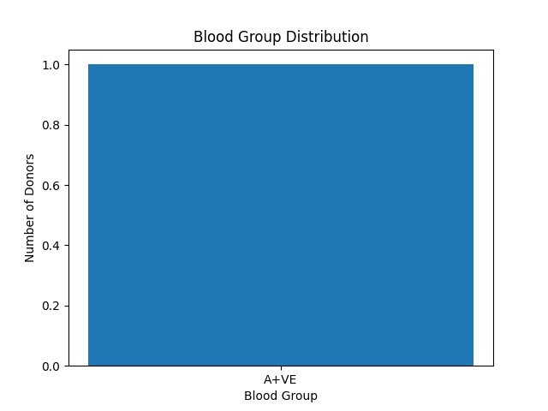
GRAPH:-

Slide 12

RESULT :
Result analysis for a blood bank management system typically involves assessing various metrics and outcomes to evaluate the effectiveness and efficiency of the system..
By analyzing all the features and benefits of the blood bank management system, stakeholders can gain insights into its effectiveness, identify areas for improvement, and ultimately enhance the quality of blood services provided to the community.

Slide 13

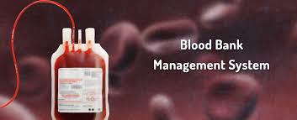
Conclusion and Next Steps
After analyzing the benefits and features of the Blood Bank Management System, the next steps involve implementation and integration into existing healthcare systems. It's crucial to train staff and conduct regular system audits to ensure efficient blood bank operations.
Furthermore, developing strategic partnerships with hospitals and community organizations will enhance blood donation drives and supply chain management.

Slide 14



